Slide 1

Customer Review Data

Slide 2

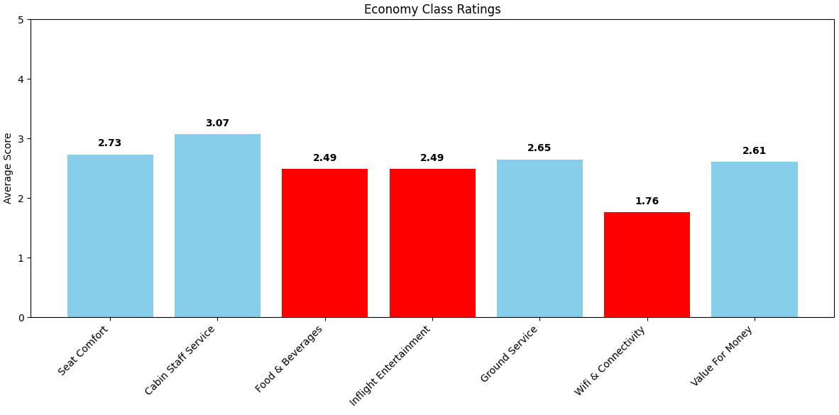
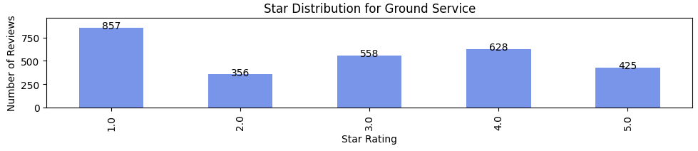
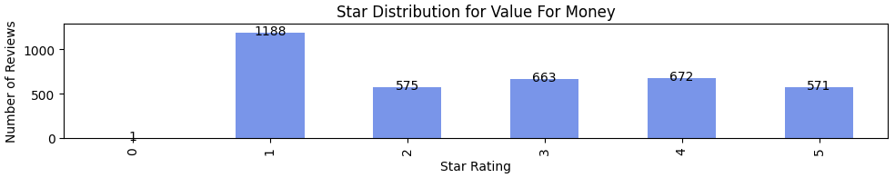
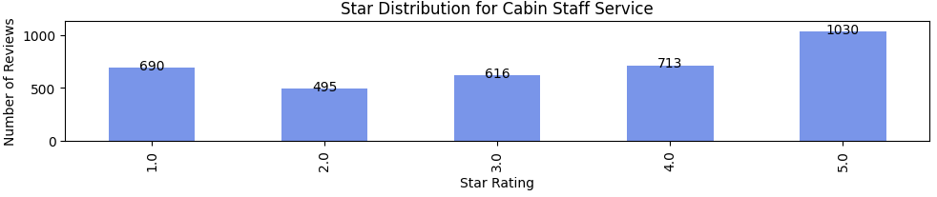
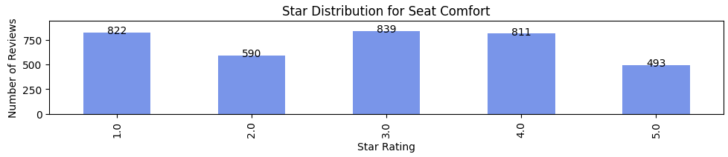
3671 Reviews
Economy Class: 1907 reviews
Business Class: 1189 reviews
Premium Economy: 360 reviews
First Class: 213 reviews
Key Findings
The Bottom 2 are the Ground Service and Value for Money.
The Economic class ha the most reviews in the page. Extracted data it has 51.99%.
The Top 2 are the Cabin Staff and Seat Comfort.
Primary Focus: Elevate the Economy Class experience.
Ground Service: Prioritize efficient and pleasant customer interactions.
Wifi & Connectivity: Invest in a faster, more stable connection for passengers.
Food & Beverages: Revise and improve menu offerings for better customer satisfaction.

